Slide 1
Dealing with Dates and Times in R
MSACL 2022

Slide 2
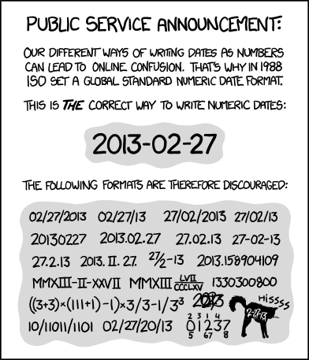
https://xkcd.com/1179/

Slide 3
Definitions for dates and times
R (and programming languages in general) often utilize structured representations for dates and times
Dates and times may be represented separately
Or represented within one field as a date-time
Date-times are often the most useful default representation for both entities
Generally easy to split this apart if needed
Date-times labeled as <dttm> data type in tidyverse representations of data frames (tibbles)
In base R date-times may be referred to as POSIXct
Refer to R4DS: https://r4ds.had.co.nz/dates-and-times.html

Slide 4
Lubridate is built to parse dates and times
lubridate is a package built to handle the nuances of dates and times, including:
Time zones
Daylight savings time
Intervals between timestamps
lubridate is a package that is installed with the tidyverse group of packages
But it is not a core package so you have to call it explicitly
library(lubridate)

Slide 5
What if I need Dates or Times for right now?
Outputs today’s date as a date data type
e.g. 2022-04-26
Outputs a timestamp (date + time) as a date-time data type
e.g. 2022-04-26 08:47:47 PDT
today()
now()

Slide 6
How can I extract dates and times from strings?
Dates and times frequently within a text file with arbitrary formatting
2022-04-26
04/26/2022
26/04/2022
04.26.2022
Lubridate offers functions to map text strings based on the sequence of years, months, days, hours, minutes, seconds
ymd("2017-01-31")
#> [1] "2017-01-31"
mdy("January 31st, 2017")
#> [1] "2017-01-31"
dmy("31-Jan-2017")
#> [1] "2017-01-31"
ymd_hms("2017-01-31 20:11:59")
#> [1] "2017-01-31 20:11:59 UTC"
mdy_hm("01/31/2017 08:01")
#> [1] "2017-01-31 08:01:00 UTC"

Slide 7
Functions for converting between Dates and Date-Times
function converts a date into a date-time
function converts a date-time into a date
output is a date
output is a date-time
as_datetime(today())
as_date(now())
#> [1] "2020-10-09 UTC"
#> [1] "2020-10-09"

Slide 8
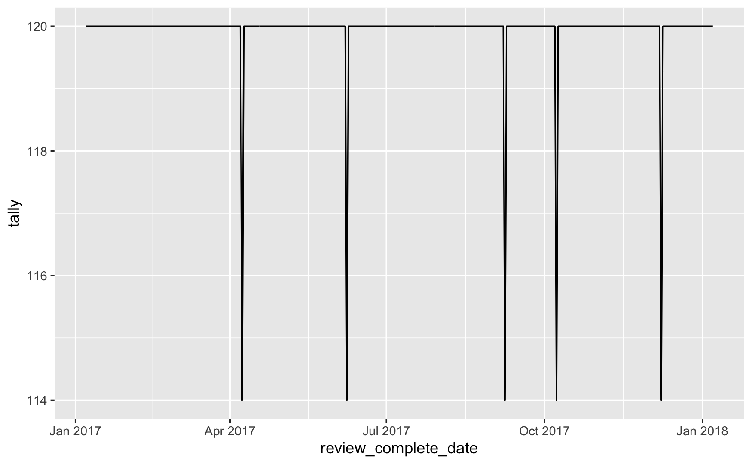
Date format conversion can help with counting
batches_ts <- all_batches %>%
mutate(review_complete_date = as_date(review_complete_timestamp))
review_count <- batches_ts %>%
group_by(review_complete_date) %>%
summarize(tally = n())
ggplot(review_count, aes(x = review_complete_date, y = tally)) +
geom_line()

Slide 9
Datetimes can be built from components
flights %>%
select(year, month, day, hour, minute) %>%
mutate(departure = make_datetime(year, month, day, hour, minute))
#> # A tibble: 336,776 x 6
#> year month day hour minute departure
#> <int> <int> <int> <dbl> <dbl> <dttm>
#> 1 2013 1 1 5 15 2013-01-01 05:15:00
#> 2 2013 1 1 5 29 2013-01-01 05:29:00
#> 3 2013 1 1 5 40 2013-01-01 05:40:00
#> 4 2013 1 1 5 45 2013-01-01 05:45:00
#> 5 2013 1 1 6 0 2013-01-01 06:00:00
#> 6 2013 1 1 5 58 2013-01-01 05:58:00
#> # … with 336,770 more rows

Slide 10
Accessor functions extract components of dates
datetime <- ymd_hms("2016-07-08 12:34:56")
year(datetime)
#> [1] 2016
month(datetime)
#> [1] 7
mday(datetime)
#> [1] 8
yday(datetime)
#> [1] 190
wday(datetime)
#> [1] 6
month(datetime, label = TRUE)
#> [1] Jul
#> 12 Levels: Jan < Feb < Mar < Apr < May < Jun < Jul < Aug < Sep < ... < Dec
wday(datetime, label = TRUE, abbr = FALSE)
#> [1] Friday
#> 7 Levels: Sunday < Monday < Tuesday < Wednesday < Thursday < ... < Saturday

Slide 11
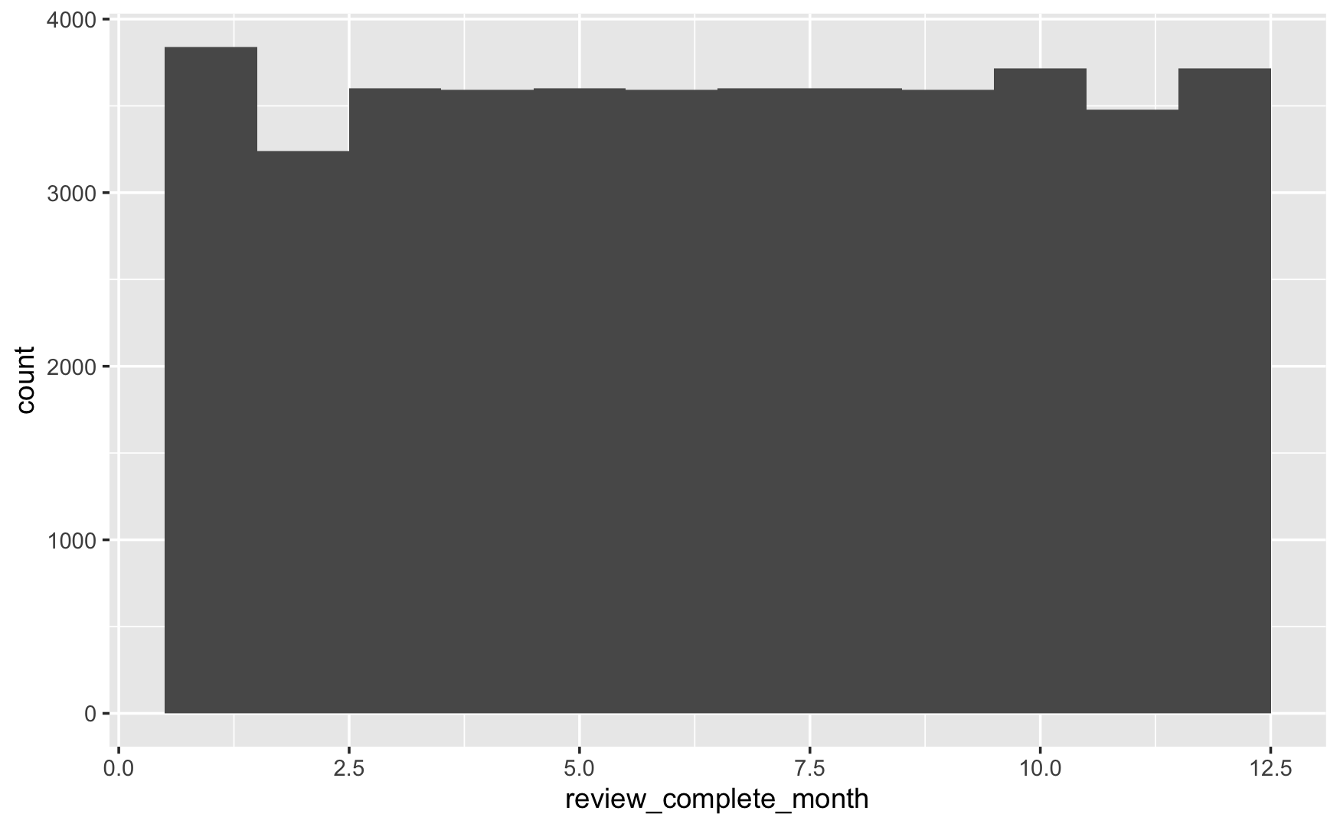
Date format conversion can help with counting
batches_monthly <- all_batches %>%
mutate(review_complete_month = month(review_complete_timestamp))
ggplot(batches_monthly, aes(x = review_complete_month)) +
geom_histogram(bins = 12)

Slide 12
Exercise 1
Make sure you run the first chunk of the lesson to load all the batch data.
What days of the week is the lab open? During what hours does the lab team typically review data? Aggregate the review complete timestamp at different levels and visualize the results.

Slide 13
Rounding Dates may be more helpful than extracting parts of dates and times
Extracting a week or a month from a date may be less helpful when analyzing data spanning years
month(“2022-01-16”) = 1
month(“2021-01-16”) = 1
Floor and ceiling date functions round dates but generate a date-time as output
floor functions round down
date-time object is first argument
specify unit for rounding
floor_date(ymd("2022-01-16"), unit = "months”)
[1] "2022-01-01"

Slide 14
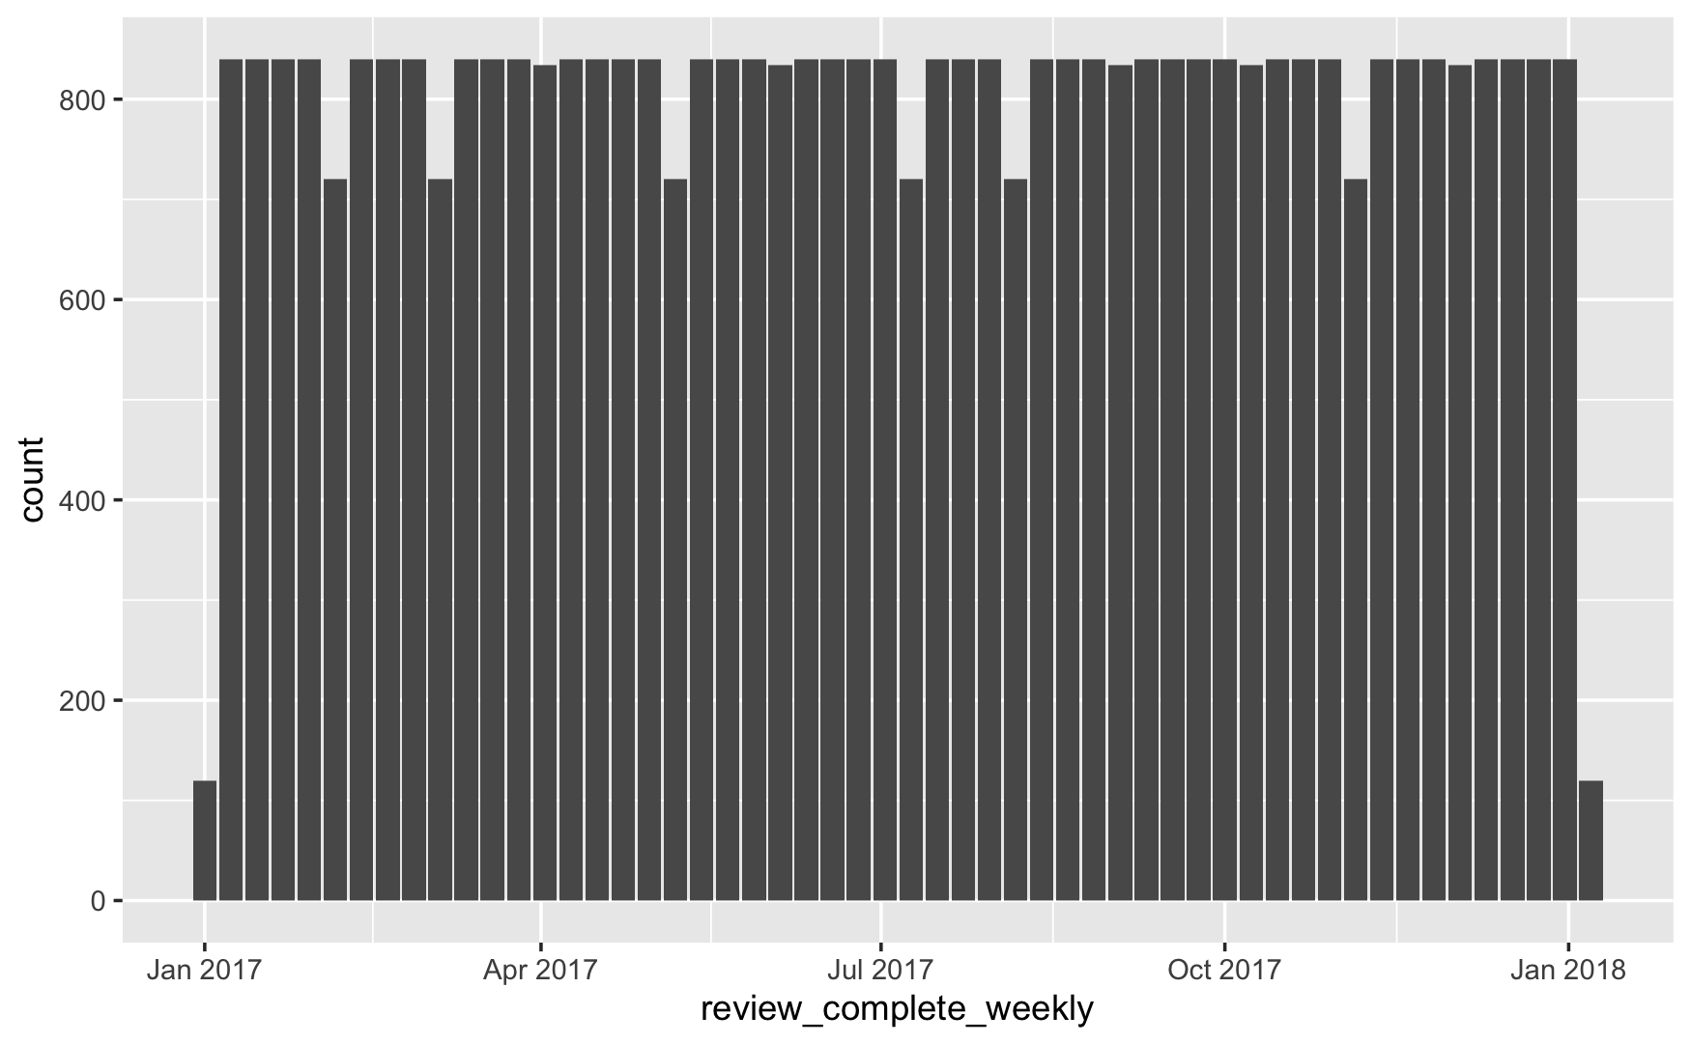
Rounding can improve summarization and visualizations
batches_weekly <- all_batches %>%
mutate(review_complete_weekly = floor_date(review_complete_timestamp, unit = "week"))
batches_weekly %>% count(review_complete_weekly)
ggplot(batches_weekly, aes(x = review_complete_weekly)) +
geom_bar()

Slide 15
Performing arithmetic on dates is a common when analyzing lab data
Lubridate supports a multiple data structures intended to capture time spans
Durations represent seconds
Periods represent useful units such as weeks or months
Intervals represent a starting and ending point
Lubridate functions improve the utility of these structures

Slide 16
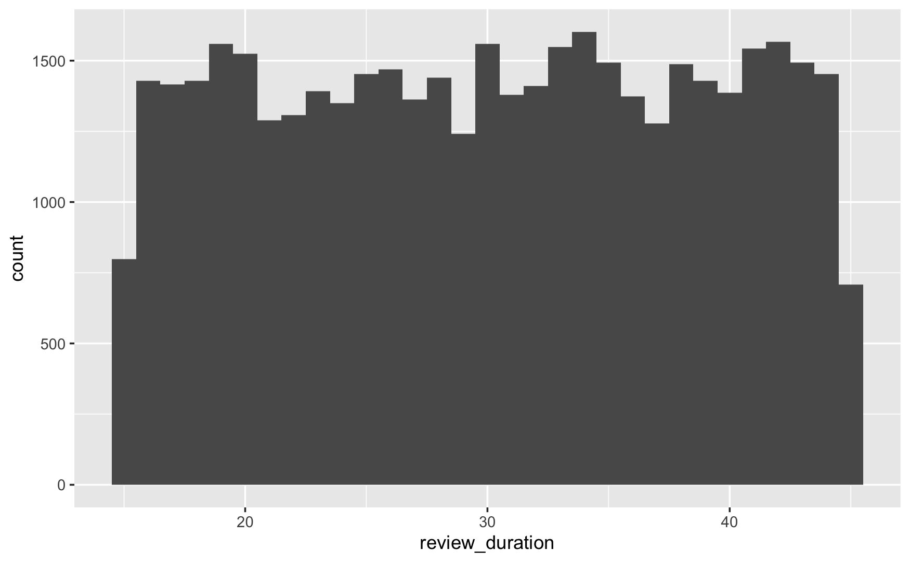
Difftime object output can be unpredictable
Subtracting dates in R produces a difftime object
batches_tat <- all_batches %>%
mutate(review_duration = review_complete_timestamp - review_start_timestamp)
ggplot(batches_tat, aes(x = review_duration)) +
geom_histogram(binwidth = 1)
review_start | review_complete | review_duration
2017-01-07 13:43:00 | 2017-01-07 14:09:00 | 26 mins
2017-01-07 11:15:00 | 2017-01-07 11:48:00 | 33 mins
2017-01-07 09:22:00 | 2017-01-07 10:05:00 | 43 mins

Slide 17
Difftime objects can be converted to durations for greater consistency
convert to duration
batches_tat <- all_batches %>%
mutate(review_duration = as.duration(review_complete_timestamp - review_start_timestamp))
review_start | review_complete | review_duration
2017-01-07 13:43:00 | 2017-01-07 14:09:00 | 1560s (~26 minutes)
2017-01-07 11:15:00 | 2017-01-07 11:48:00 | 1980s (~33 minutes)
2017-01-07 09:22:00 | 2017-01-07 10:05:00 | 2580s (~43 minutes)

Slide 18
Constructor functions can be used to create durations
dseconds(15)
#> [1] "15s"
dminutes(10)
#> [1] "600s (~10 minutes)"
dhours(c(12, 24))
#> [1] "43200s (~12 hours)" "86400s (~1 days)"
ddays(0:5)
#> [1] "0s" "86400s (~1 days)" "172800s (~2 days)"
#> [4] "259200s (~3 days)" "345600s (~4 days)" "432000s (~5 days)"
dweeks(3)
#> [1] "1814400s (~3 weeks)"
dyears(1)
#> [1] "31557600s (~1 years)"

Slide 19
Period functions help with adding human times to date-times
Naming for period functions is intuitive – the function name is the human label for the period
Period functions account for exceptions such as leap year or daylight savings
# A leap year
ymd("2016-01-01") + dyears(1)
#> [1] "2016-12-31 06:00:00 UTC"
ymd("2016-01-01") + years(1)
#> [1] "2017-01-01"
# Daylight Savings Time
one_pm + ddays(1)
#> [1] "2016-03-13 14:00:00 EDT"
one_pm + days(1)
#> [1] "2016-03-13 13:00:00 EDT"
seconds(15)
#> [1] "15S"
minutes(10)
#> [1] "10M 0S"
hours(c(12, 24))
#> [1] "12H 0M 0S" "24H 0M 0S"
days(7)
#> [1] "7d 0H 0M 0S"

Slide 20
Intervals are durations that include a starting point
Interval calculation performed by a special date subtraction function: %--%
add 1 year to today
next_year <- today() + years(1)
(today() %--% next_year) / ddays(1)
#> [1] 365
interval calculation
divide by duration for numeric output

Slide 21
Exercise 2
The lab has set a turnaround time goal of reviewing all batches within 40 minutes. Add a variable that captures the review turnaround time in minutes. Using the if_else() function (review how it works in the help documentation if needed), create a new logical variable (column) called "meets_tat" that returns a FALSE for all batches that take longer than 40 minutes from review start to review completion. Add another variable that helps to aggregate the data by week. Add a variable that captures the review turnaround time in minutes.
a) Plot a histogram showing the distribution of batch review times (it is OK to include duplicate review times for different compounds in the same batch).
b) Create a visualization that shows the weekly volume of reviews and is color coded by the number of reviews that meet the turnaround time requirement.

Slide 22
Summary
Lubridate functions support arithmetic with dates and times
Functions such as ymd_hms() are built to convert arbitrary string representations of dates and times into date/time objects
Other functions such such as month() can output a single component of a date
Durations are consistent representations of time differences
Periods represent useful human friendly units such as weeks or months
Intervals represent durations with a defined starting and ending point

